Slide 1
Measuring Experience
Part 2
Canada.ca
February 15, 2018
Gerry McGovern
customercarewords.com

Slide 2
Digital
Teams

Slide 3
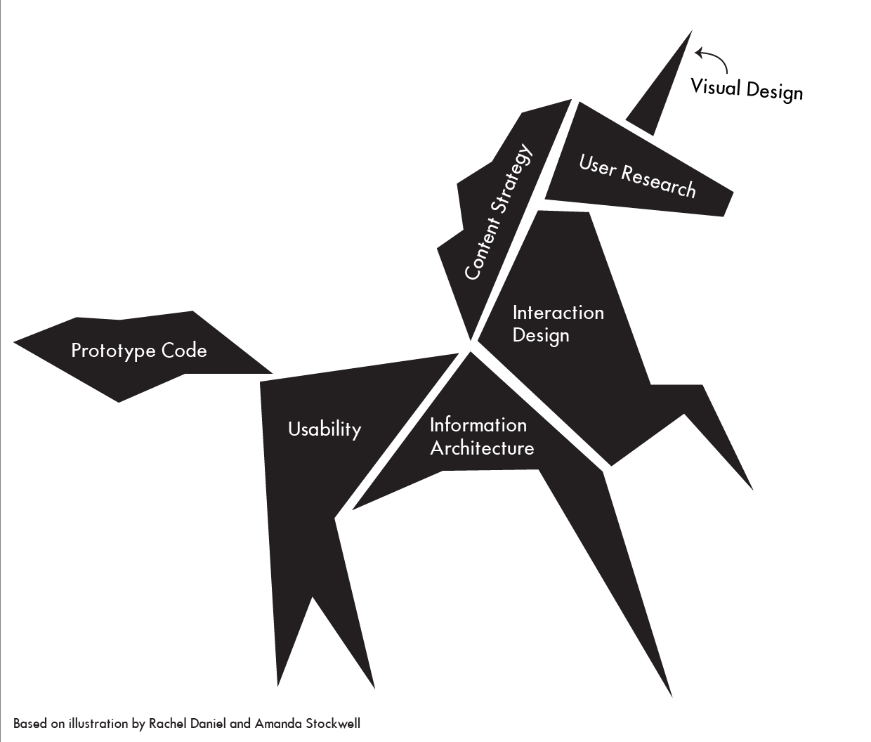

Slide 4
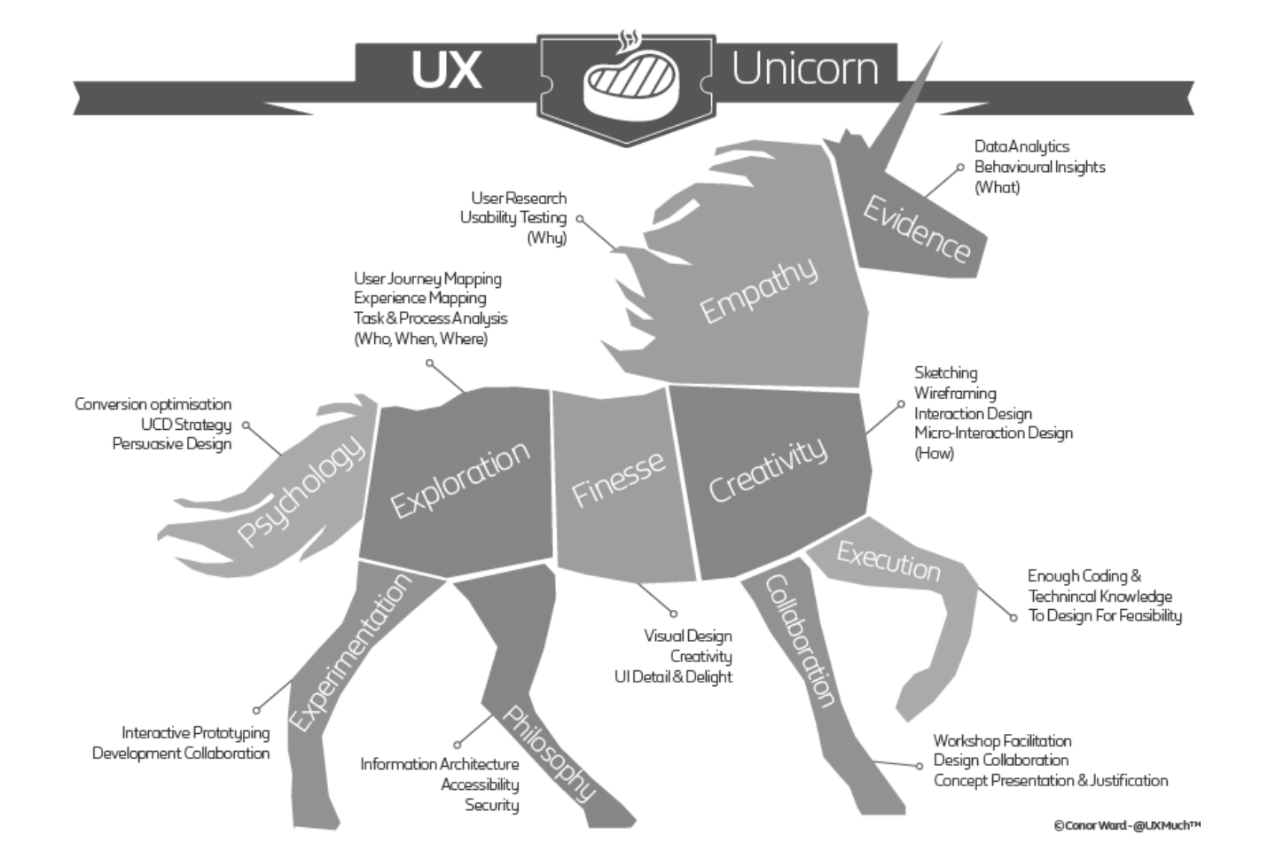

Slide 5
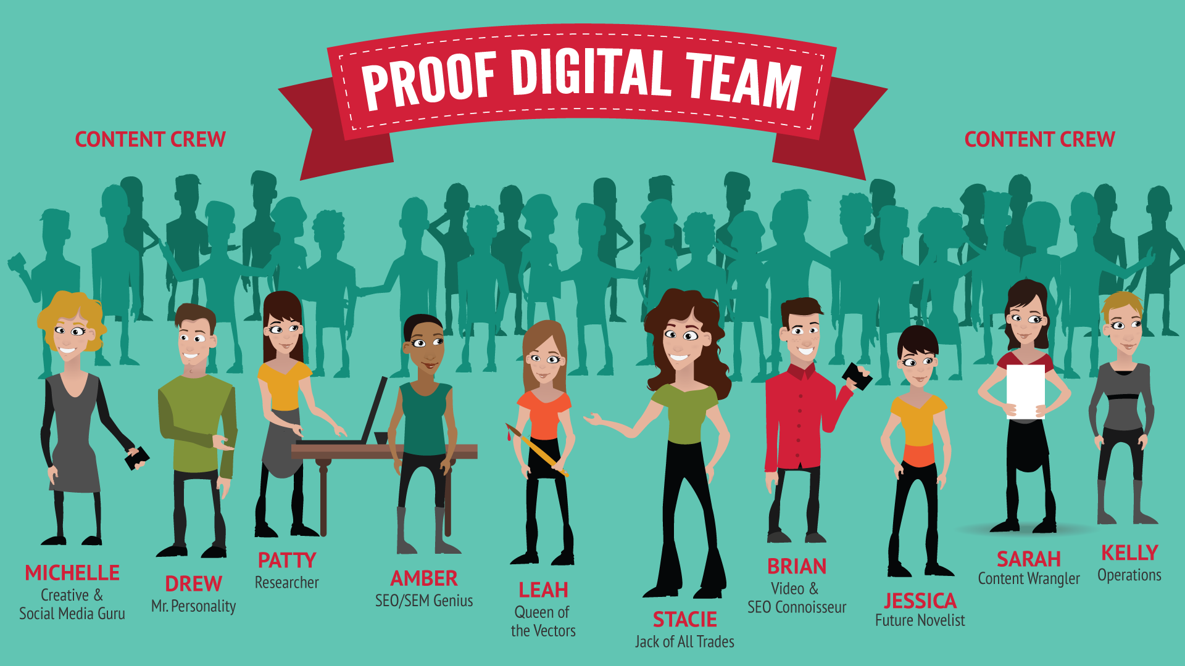

Slide 6

Why is specialization a no brainer?
Monetising Managers
(Behavioural Economics)
UX Writers
(Copywriters)
DVX (Data visualization experience) designers
(Data Scientists)
UX Analyst (Mathematicians/Statisticians)
UX Researcher
(Neuropsychologists, Neuroscientists)
UX Prototyper
(Software Engineers)
Om Tandon

Slide 7
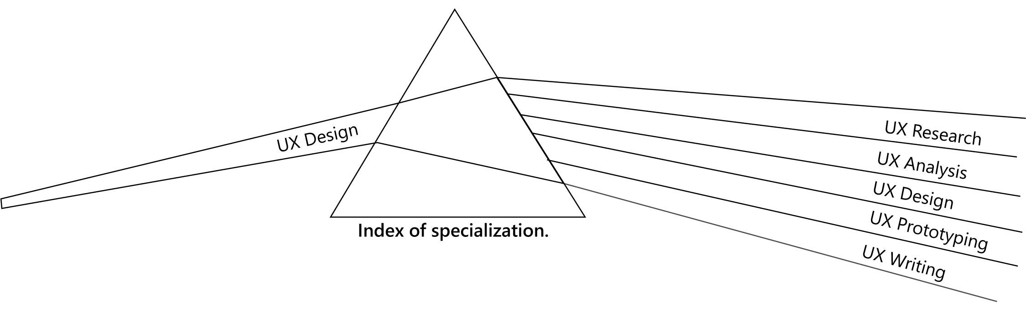

Why is specialization a no brainer?

Slide 8
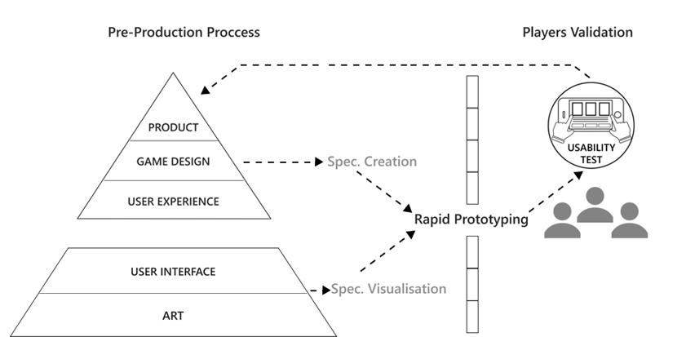
Vertical stack integration
Om Tandon

Slide 9
CRA’s approach to UCD requires everyone’s input
Users
Business Programs
Technical Constraints
UCD Design Team

Slide 10








Multi-disciplinary Team of Experts
Chief Designer
Supporting Graphic Designer
Business Analysts
User Research and Testing Specialist
IT Application and Usability Specialist
IT Specialists
Senior IT Technical Support
WCAG Technical Support
All supported by a dedicated Project Management Office

Slide 11
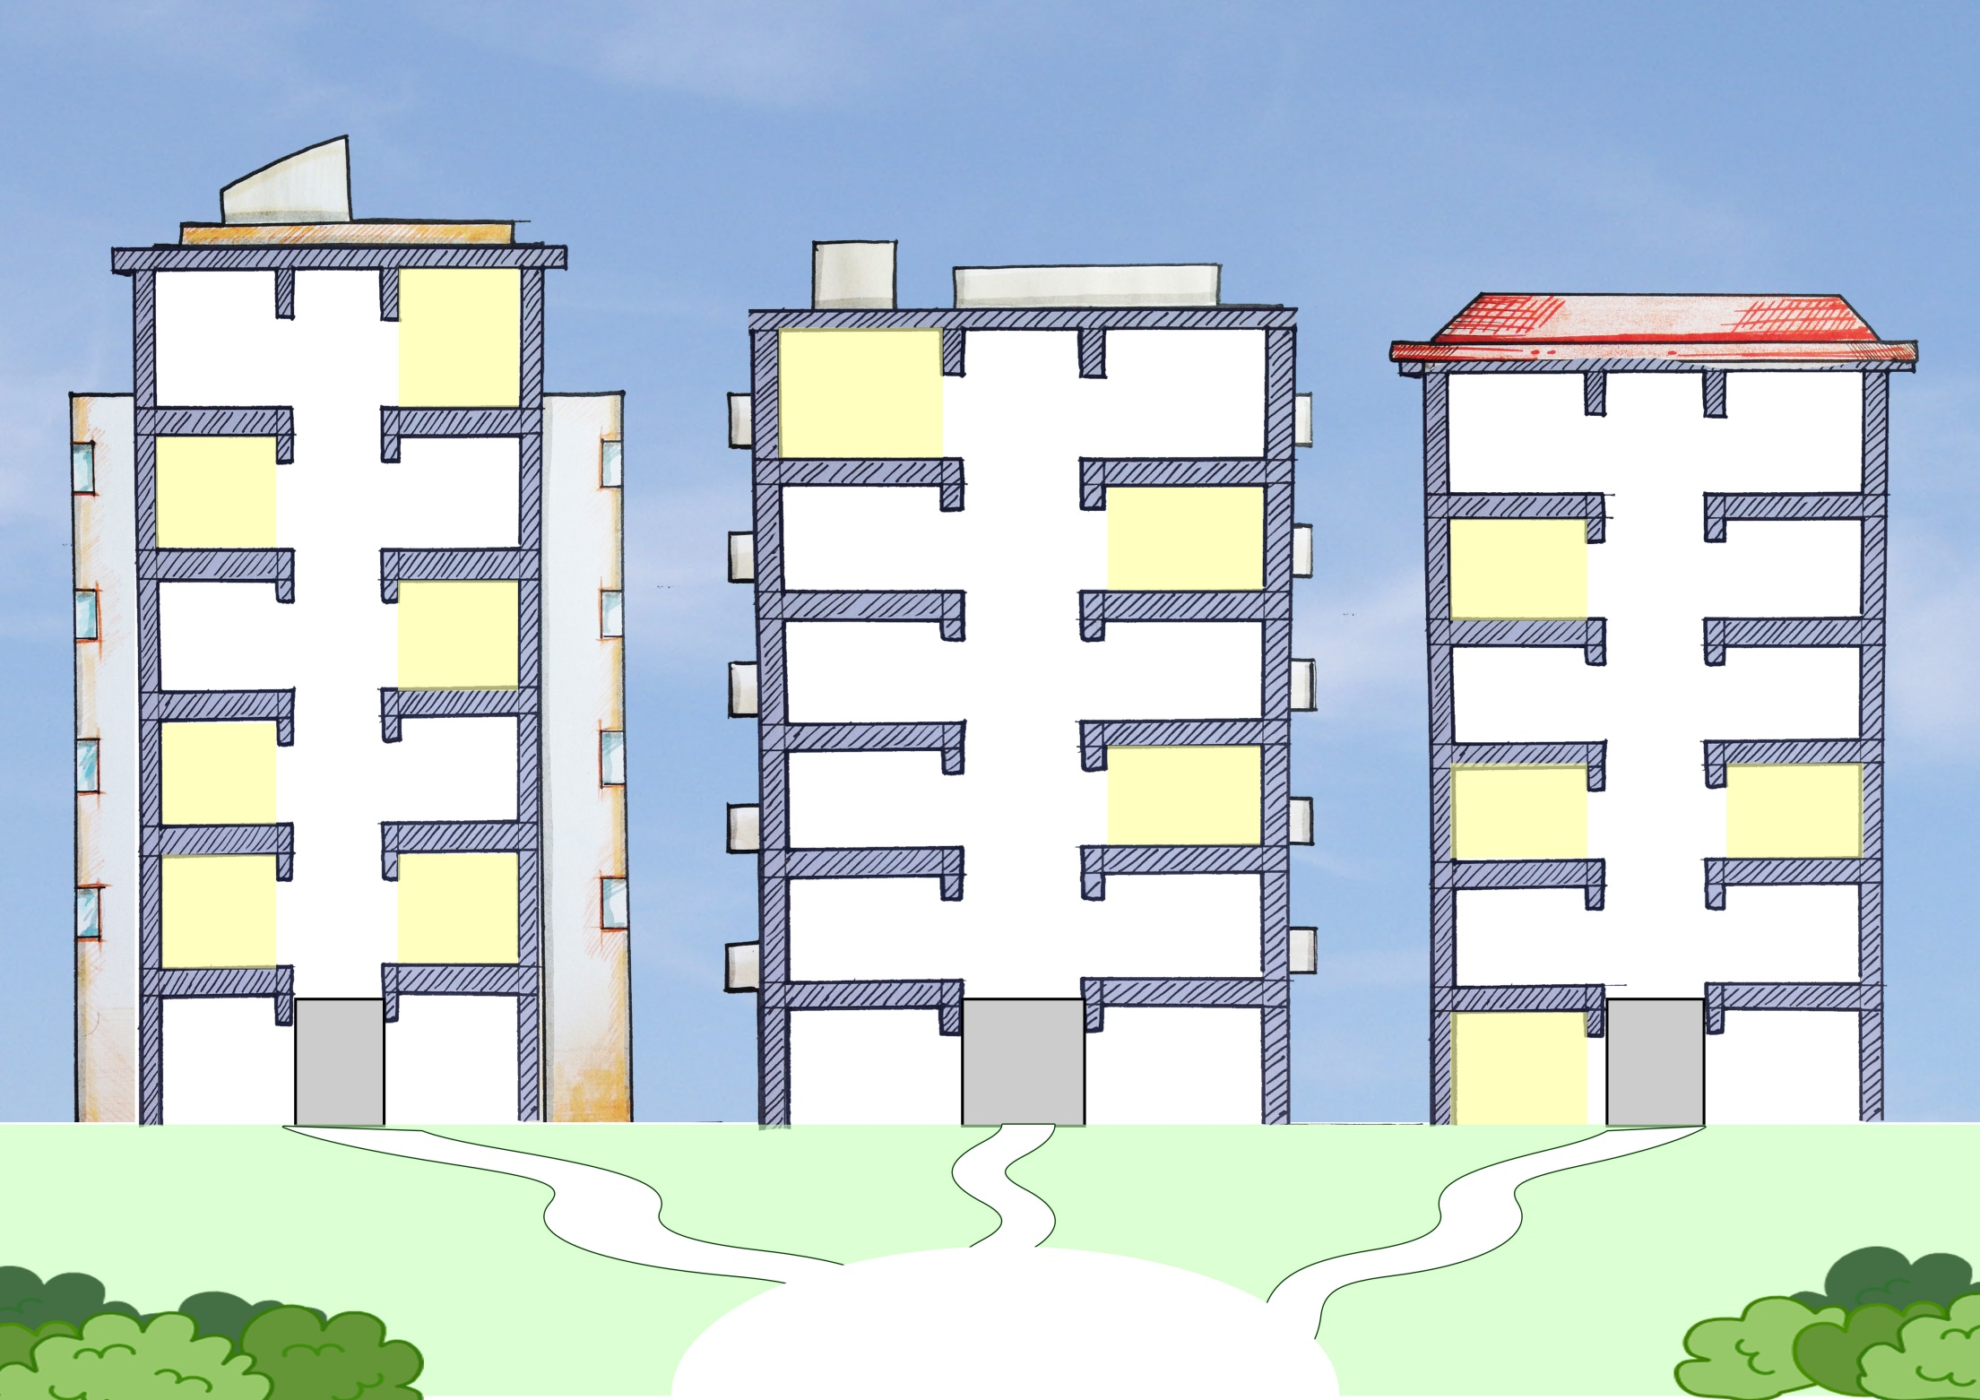
Law
Law
Law
We will build a common architecture for ALL 77 tasks.
We will focus first on what matters most to most people: the TOP tasks.

Slide 12

All 77 tasks, starting with the TOP tasks, will be made more accessible.
The future is collaborative!

Slide 13
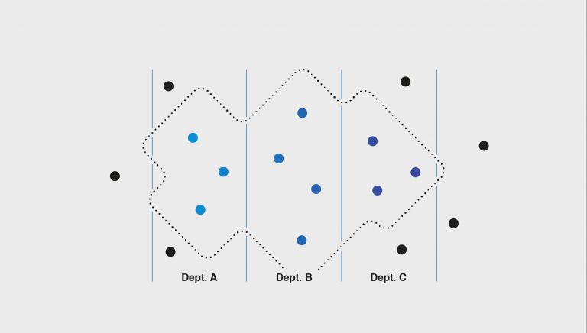
GOV.UK: Starting a Business
Education
Companies
House
International Trade
Health & Safety
Food
Standards
Work &
Pensions
Revenue
Business
Notes:
GOV.UK
https://gds.blog.gov.uk/2018/01/08/how-cross-government-communities-can-support-cross-government-services/
How cross-government communities can support cross-government services
Posted by: Tom Wynne-Morgan and Will Harmer, Posted on: 8 January 2018 - Categories: People and skills, Ways of working
To a user, a service is simple. It’s something that helps them to do something – like learn to drive or start a business. But for government, creating and delivering these services can be much more complex.
This is because there are often lots of people across lots of different parts of government involved in delivering these services. They might be working hard on their part of the service but they might not have a picture of the full service or know how to work with others involved in it.
To help tackle this issue, GDS is working with organisations across government to pilot a new way of working. We are forming networks of people with different skills and from different departments, who will work together to improve end-to-end services that cross departmental boundaries. We’re calling these networks ‘Service Communities’.
We already have communities of practice across government, that bring together people working in design or user research, for example. The new Service Communities will bring together people from across these professional boundaries. People in the communities will be united by the service they work on.
We’ve started to test this concept with the ‘Starting a Business’ community, which brings together people working to help users start a business. They’re people in different roles and from different organisations – such as HMRC, Department for Work and Pensions (DWP) and Department for Business, Energy and Industrial Strategy (BEIS).
Here’s why we’re doing this work and what we’ve done so far.
The strength of communities
Last year we carried out research into how government services get made. This research showed us that there wasn’t a single, coherent way that government services are made. Instead, there is variation from department to department. And there are silos between different areas and professions – for example, between policy and delivery.
It’s clear that we need to address this issue, particularly as the Government Transformation Strategy sets out a commitment to ‘build services that run seamlessly across government’.
GDS is currently running a number of projects that support the development of end-to-end services. For example, we’re updating the Service Standard to take into account whole services. We’re starting to show full service journeys on GOV.UK. And we’re working to help departments publish data about end-to-end services.
Our Service Communities work will build on and support all of this by bringing together everyone involved in delivering a particular service to act as one team.
The people in these communities will share things that will help them build coherent end-to-end services. These could be things like user research, data and back-end technology. They could update each other on live projects and support each other around common issues and blockers.
What have we done so far?
We’re trialling this approach with the ‘Starting a Business’ community. We chose this area because the user journey for starting a business is relatively straightforward and is not owned by any particular department. It also meant we could build on work that HMRC had been doing on business startups, as well as a cross-departmental network that had been assembled by the Transformation Peer Group.
The community features people in a range of different roles, including policy, strategy, design and administration. It has representatives from HMRC, DWP, BEIS, the Department for Education, Companies House, the Department for International Trade, the Pensions Regulator and the British Business Bank. As the community matures, we intend to involve other organisations, including those outside government. We’re already talking to the Food Standards Agency and the Health and Safety Executive.
We’ve held a number of workshops with this group. We’ve mapped out the service journey for starting a business and we’ve looked at the community’s capabilities and any gaps.
The group has also been looking at how to make sure the communities are sustainable. For example, looking at how regularly they meet, how they’re structured and who owns them.
What have we learned so far?
Just as there are challenges in building government services, there are challenges in building government Service Communities.
In terms of building the community, one of the challenges we’ve faced is finding a common communication channel that can be used by all departments, as many channels are currently used by some departments but blocked by others.
We’ve also found that because the service community is quite large, it can be difficult for everyone to meet regularly. To address this, we’re beginning to create smaller groups within the community, focused around areas of the service, such as user research. They could meet more regularly and feed back to the larger community.
In terms of how the community operates, we’ve found that it can be difficult to align work across different departments. For example, for some departments clearing a new policy change could take months while another might be weeks.
And because delivery is always happening, we can never have a blank slate, take stock of everything and design the 'perfect solution'. We have to accept that things are always being delivered as we go along.
Despite these challenges, we’ve found that there’s a real appetite for cross-government collaboration and that the community has worked well together on projects such as mapping out the end-to-end user journey for the service.
What’s next?
The ‘Starting a Business’ community meets regularly. We’re continuing to iterate the end-to-end service map so that this can be the starting point for any work on the service this year. We’re also starting to look at data sharing in the service and how user researchers across the service can work together.
We’re also continuing to develop the Service Communities concept. We know that there are similar communities and networks already in existence across government and we’d like to link up with them so that we can all work together.

Slide 14
Canada.ca design team
Interaction designers
Prototypes
Mockups / concepts
Design system (patterns, libraries, code, etc.)
Service designers
Problem analysis
Opportunity analysis
Leading
Coordination
Facilitation
Accessibility
User Researchers
Usability testing
Behaviour research
Optimization
Data analytics
Content designers
Content creation
Editing
Review and optimization
Content Style Guide

Slide 15
Canada.ca co-designers
Subject matter experts
Department expertise
Policy
Underlying process
Constraints and opportunities
Technical Development
Coding
Platform management

Slide 16
Perfect team – if we could just choose one role
Coordinating function – make sure everything is on track – assuming there is an all-star team
UX unicorn – unrealistic
Coder – who can actually code
UX Researcher (5)
Data Scientist (1)
Client service representative – focused on what client wants
Content Designer – (18) – where people fail

Slide 17
Perfect team – essential roles
Content simplifier
  content specialist – designer – writer – interaction designer
  works with words – making it happen on prototypes – borrow?
  The new language, for interacting, action, navigation, buttons, not language for paper – simplified but still conveys the point
UX researcher
  testing included – understanding behaviour
Coding, prototyping
  Can build – interaction designer
Others (may be different with each project)
  Subject matter expert
  Policy – to help simplify – fit policies for analog world into digital
  Business Analyst – align to organization objectives and mandate – so what
  Champion to get what is built live – product owner – manager – team lead

Slide 18
Perfect team – essential roles
Content simplifier
  Content specialist – designer – writer
  Works with words – making it happen on prototypes – borrow?
  The new language, for interacting, action, navigation, buttons, not language for paper – simplified but still conveys the point
UX researcher
  Testing – behavioural – understanding behaviour – data scientist
Interaction designer (coding, prototyping)
  Can build – applies patterns and design elements – how people use it
Customer contact – or support or contact centre

Slide 19
Perfect team – supporting roles
Subject matter expert
  Policy expert – to help simplify – fit policies for analog world into digital
  By interviews etc – if it is not their job to be on the team
  Approve – may not be involved in prototyping – but must get their approval
Project management – coordinator
Business Analyst
  Align to organization objectives and mandate – so what – why do this – ROI – write the plan
Heavy coding
  IT – change the system – how things should work – integrated
Marketing, communications – marketing strategies
Owner, product, service – management-level product responsibility
  Champion to get what is built live – manager – team lead

Slide 20
Perfect team

Slide 21
How To
Measure

Slide 22
Top Performance Indicator
Top Tasks
Measure
Improve
Measure
Notes:
22

Slide 23
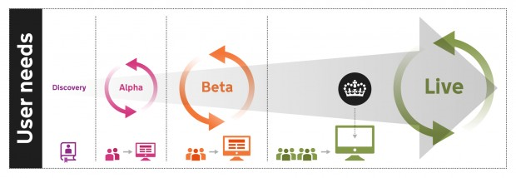

Slide 24
Choosing tasks

Slide 25
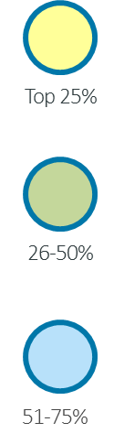
Please look at the following list and choose the top 5 reasons you come to the OECD.
 | Tasks | Total Vote | % of Total Vote 31800 | Cumulative Vote | Cumulative Tasks
1 | Country surveys / reviews / reports | 2178 | 6.8% | 6.8% | 1.4%
2 | Compare country statistical data | 1960 | 6.2% | 13.0% | 2.9%
3 | Statistics on one particular topic | 1869 | 5.9% | 18.9% | 4.3%
4 | Browse a publication online for free | 1610 | 5.1% | 24.0% | 5.7%
5 | Working papers | 1530 | 4.8% | 28.8% | 7.1%
6 | Publication by topic | 1478 | 4.6% | 33.4% | 8.6%
7 | Basic facts, summaries and overviews | 1379 | 4.3% | 37.7% | 10.0%
8 | Statistics on one particular country | 1285 | 4.0% | 41.8% | 11.4%
9 | Statistical forecasts / projections | 1210 | 3.8% | 45.6% | 12.9%
10 | Access to raw data | 1051 | 3.3% | 48.9% | 14.3%
11 | International guidelines and standards (corporate governance, tax havens, etc.) | 1025 | 3.2% | 52.1% | 15.7%
12 | Statistical sources and methods | 1019 | 3.2% | 55.3% | 17.1%
13 | What's new (hot topics, recent publications, events) | 1004 | 3.2% | 58.5% | 18.6%
14 | OECD policy advice by topic, country | 843 | 2.7% | 61.1% | 20.0%
15 | OECD Annual Report | 784 | 2.5% | 63.6% | 21.4%
16 | Publication by country | 746 | 2.3% | 65.9% | 22.9%
17 | Best practice in policy implementation | 739 | 2.3% | 68.3% | 24.3%
18 | Publication by title | 614 | 1.9% | 70.2% | 25.7%
19 | Simple, easy-to-understand tables and graphs | 613 | 1.9% | 72.1% | 27.1%
20 | News releases | 542 | 1.7% | 73.8% | 28.6%

Slide 26
Choosing what tasks to measure
OECD Top Tasks | Qs
Country surveys / reviews / reports | 2
Compare country statistical data | 2
Statistics on one particular topic | 1
Browse a publication online for free | 1
Working papers | 1
Publication by topic | 1
Basic facts, summaries and overviews | 1
Statistics on one particular country | 1
Statistical forecasts / projections | 1
Access to raw data | 1
Total Task instructions | 12
3

Slide 27
Choosing customers

Slide 28
These data are from 16 different studies with different tasks and varying between 15 and 31 participants

Slide 29
Creating task instructions

Slide 30
Creating task instructions
  Start with the answer, not the instruction
  Representative, typical, fixable
  Repeatable
  Does not contain clues – Anti-Search Engine Optimization
  Be specific: one task, one unique answer
  Independent, different
  Short and clear– 30 words or less
  Target time: 20 seconds minimum; 2 minutes maximum

Slide 31
Creating task instructions – Representative, typical, fixable
  Select task instructions that are typical of the top task in question.
  Do not try and choose difficult, unusual, once-off-type tasks.
  Cisco top task: Downloading software.
  Task instruction: Download the latest firmware for the RV042 router.
      This is a popular router
      Download process is reflective of many other routers that Cisco sells.

Slide 32
Creating task instructions – Repeatable
  Very important: Top Tasks is dependent on testing the same task instructions over time
  2009 OECD task instruction: In 2008, was Vietnam in the list of countries that received official development assistance?
  2013 OECD task instruction: In 2012, was Vietnam in the list of countries that received official development assistance?
  Ongoing Cisco task instruction: Download the latest firmware for the RV042 router.

Slide 33
Task instruction: Pretend you have forgotten the password for the Cisco account and take whatever actions are required to log in.
Notes:
7. TPI is a surveillance tool. In order to routinely monitor the performance of the site, we have decided to conduct a Support TPI study every quarter. Therefore, we have selected 10 support tasks that are tested each time so that we can identify improvement or relapses against a benchmark. These make up the Support TPI.
The support TPI is overall TPI score is roughly an average of the score of all 10 tasks.

Slide 34

Creating task instructions – No hidden clues
  Do not have any clues within the task instruction
  Opposite of Search Engine Optimization
  Copy and paste pieces of instruction into search engine
  Hide the true intent of the task, where possible
  NO: Find the maternity leave policy
  YES: Your colleague is pregnant. How many months can she take off?
3

Slide 35

Creating task instructions – 30 words or less
  Pasting into chat – short-term memory
  Shorter the better
  Aim for 20 words or less
  Maximum of 30 words
3

Slide 36
Customer journeys

Slide 37
Customer journeys for task instructions
  Top Task 3 for NetApp: Data protection
  Task Instruction: Find a document that gives you the ten key benefits of NetApp SnapVault.
  Expected Customer Journey:
  NetApp.com homepage
  Click on ‘Products’ in the Products Mega Menu
  Click on ‘Data Protection Software’
  On the ‘NetApp Data Protection Software’ page, click on ‘SnapVault’
  On the ‘SnapVault’ product page, go to ‘More info’ on the right-hand side, then click on ‘SnapVault Top Reasons PDF’
  Landing page: http://www.netapp.com/us/system/pdf-reader.aspx?cc=us&m=ds-5944.pdf&pdfUri=tcm:10-120975
  Answer: ‘Top Reasons – Why Use NetApp Snap Vault Replication-Based Disk-to-Disk Backup’ PDF

Slide 38
Customer journeys for task instructions – Start point
  Two general options:
  Blank tab
  Homepage:
      Less perfect
      Better for less advanced environments
      You will probably learn more

Slide 39

Creating task instructions
Target time
    30-90 second target range
    20 seconds minimum
    2 minutes maximum
    5 minute time limit
    All task instructions should have roughly same target time

Slide 40
REMOTE
OBSERVATION

Slide 41
FASTER

Slide 42
CHEAPER

Slide 43
BETTER

Slide 44
Skills required to measure

Slide 45

Skills required to measure
  Empathetic
  Humble
  Analytical
  Methodical
  Patient
  Quiet

Slide 46
Skills required to measure – What NOT to do
No Talk Aloud
No exception spotting
No guidance, no hints
No ongoing conversation
No moods
No judgment
No answers
No background noise
No loud typing
No loud breathing
3

Slide 47
Skills required to measure
“Everything you do here is really helpful. Remember, we are not measuring you. We are measuring the website. For me, you cannot fail.”

Slide 48
Preparing for measurement

Slide 49
Preparing for measurement sessions
  Measurement period, number of observers
  Dry run / pilots
  Capturing measurement information
  What to say at beginning of session
  Beginning a task instruction
  During a task instruction
  At the end of a task instruction
  Key observations
  After the last task instruction
  Video capturing

Slide 50
Analyzing & presenting

Slide 51
Overall results: Success, Failure, Time

Slide 52


Slide 53
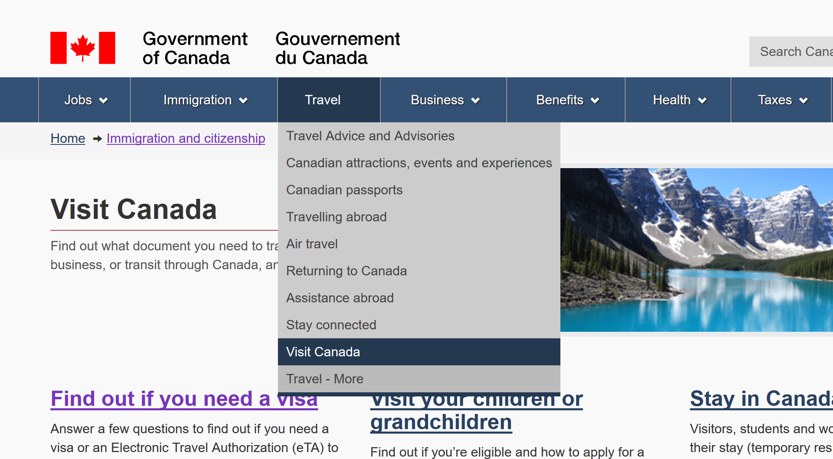

Slide 54
Continuous improvement

Slide 55
Continuous improvement
  Developing a TPI schedule
  Making people responsible for tasks
3

Slide 56
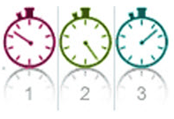
Top Tasks Management
Identify Top Tasks
Measure Top Tasks
Improve
Notes:
56

Slide 57
Thank you
WWW.
customercarewords.com
gerry@customercarewords.com
+353 87 238 6136
@gerrymcgovern

